Slide 1
Verification
The logical and physical design steps must ensure that the implemented chip meets the desired functionality and target specifications.
Verification is the process of checking the design against the given functionality and specifications.
There are mainly two types of verifications performed:
Logic verification
Physical verification

Slide 2
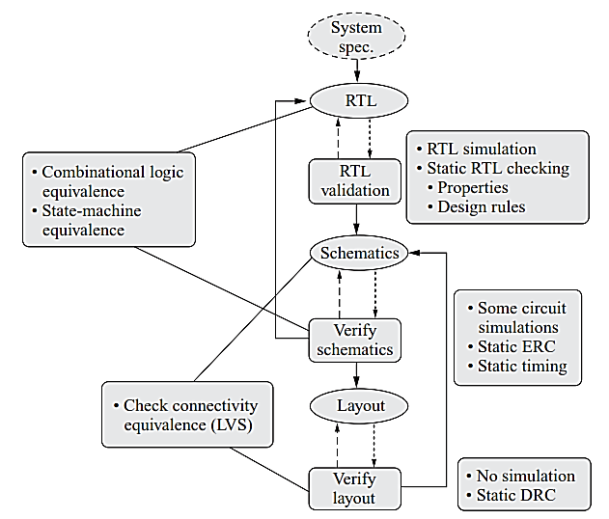
Verification Methodologies in VLSI Design Flow
Fig: Verification methodologies in VLSI design flow

Slide 3
Logic Verification
Logic verification is the process of checking the functionality of the circuit.
It can be classified into the following two categories:
Static verification
Dynamic verification (simulation-based)
In the static verification process, no simulation is performed on the circuit. It checks against some rules, such as electrical rules, design rules, schematic check, etc. It is fast as compared to the dynamic verification process.
In the dynamic verification process, the circuit is simulated to check its correctness. It is very slow but most accurate, and not applicable for the whole big system. The reduced ordered binary decision diagram (ROBDD) is widely used for logic verification.

Slide 4
Logic Verification
There are two formal approaches for logic verification:
Equivalence checking : verifies that the implementation is equivalent to the formal specification .
Model checking: verifies certain desirable properties required for a correct implementation

Slide 5
Physical Verification
Physical verification is the process of checking the layout for its correctness. At the end of the physical design phase, the layout is ready for creation of mask layers (pattern generation).
But before sending it to the pattern generator, the layout must be checked for the following rules:
Design rule check (DRC)
LVS check
Electrical rule check (ERC)
Antenna check

Slide 6
Design Rule Check
Design rules are a set of rules or guidelines for the layout of an IC.
These rules are derived from the IC fabrication process technology.
Some examples of the design rules are metal-to-metal spacing, minimum metal width, minimum poly width, poly-to-metal spacing, minimum size of the contacts, etc.
These rules are the outcome of the limitations of the fabrication process.
For example, if two metal lines are fabricated very close to each other violating the minimum spacing rule, the metal lines may be shorted to each other.
The rules mainly check:
Width
Spacing
Enclosure
The design rules are expressed in two different ways:
Micron rules
Lambda rules

Slide 7
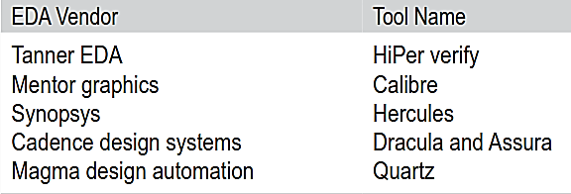
Design Rule Check
Some industry standard DRC tools

Slide 8
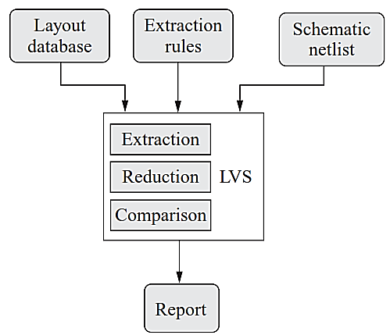
Layout Versus Schematic (LVS) checker
A typical LVS checker tool extracts the devices and their connection from the layout based on the specified extraction rules, and generates a netlist using the extracted devices and their connectivity.
Then it compares the layout netlist to the schematic netlist, and displays mismatches between the layout and the schematic, both textually and graphically.
Fig: LVS checking process

Slide 9
LVS Checker
An LVS checker performs following three basic steps
Extraction : The software program takes the layout database as input which contains all the layers, drawn to represent the circuit. It then performs logic operations between the layers to determine the device components and their connections, based on extraction rules.
Reduction : In the reduction process, the software combines the extracted components into series and parallel combinations, if possible, and generates a netlist.
Comparison : Then it compares the extracted layout netlist with the schematic netlist. If the two netlists match, it reports no LVS error, otherwise it reports the errors in a file.

Slide 10
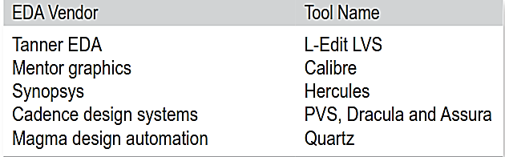
LVS Checker
Some industry standard LVS checker tools

Slide 11
Electrical Rule Check
In electrical rule check (ERC) checking,
The connectivity is checked mainly to find the floating nodes that are not connected to the ground or power.
The electrical rule checker checks for the network connectivity.
The ERC program reports the electrical connectivity issues, such as floating interconnect and devices, and abnormal connections in the physical or schematic designs.
It operates on the network generated from either the layout or the schematic.
ERC performs conventional checks, such as verifying pull-up/pull-down and isolating inactive devices.
It also converts a MOS transistor-level netlist into a gate-level netlist which can be used by gate-level simulators.

Slide 12
Cost Analysis of an IC
The total cost of the product is separated into two components:
Fixed costs
Variable costs
The variable cost includes the cost of assembly, cost of manufacturing, and the cost of parts used into the product.

Slide 13
Cost Analysis of an IC
Fixed cost has many components such as
Training cost, which includes the learning cost to learn a new EDA tool
Hardware (wafer, equipment) cost
Software (EDA tool) cost
Design (salary of designers) cost
Cost for design of test
Non-recurring engineering (NRE) cost
– Test program development cost
– Masks cost
– Simulation cost
Miscellaneous cost (insurance policy)

Slide 14
Cost of Test
Design for testability (DFT)
Chip area overhead and yield reduction
Performance overhead
Software processes of test
Test generation and fault simulation
Test programming and debugging
Manufacturing test
Automatic test equipment (ATE) capital cost
Test center operational cost

Slide 15

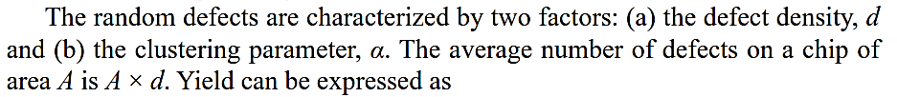


Yield Vs Company Profitability
Yield of a process determines the profitability of a semiconductor company.
Yield is defined as the ratio of number of good chips to the total number of fabricated chips on a wafer.
Yield can be written as
Final result of Exponential Yield Model

Slide 16
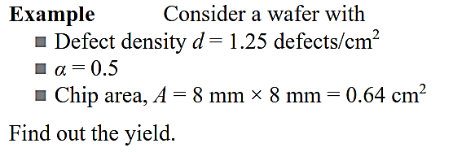
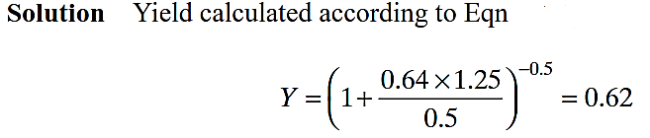
Math -1

Slide 17
Math-2
Consider a wafer with
Defect density d = 1.25 defects/cm²
clustering parameter α = 0.5 and Chip area, A = 8 mm × 8 mm = 0.64 cm²
each wafer has 500 chips
The cost of processing a wafer is $100
Calculate the processing cost per chip.
Calculate the processing cost if Design for testability (DFT) is included, which increases the chip area by 10%

Slide 18
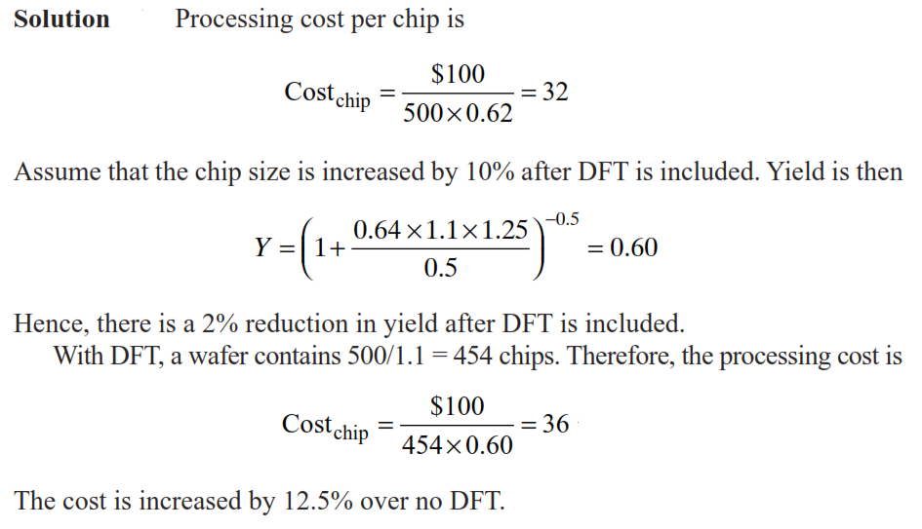
Math-2

